Slide 1

Python Machine Learning: Decision Trees
Žydrūnė Kelpšaitė
Data Analyst

Slide 2
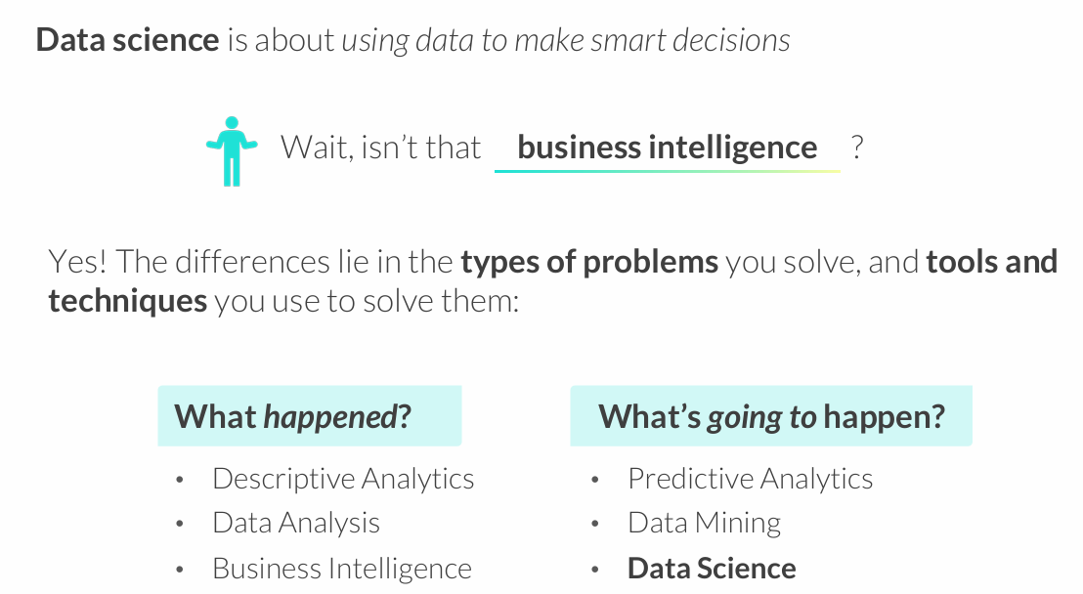
WHAT IS DATA SCIENCE?

Slide 3
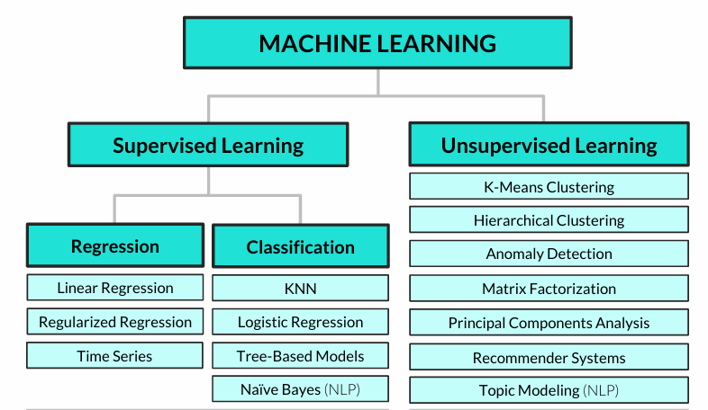
Common machine learning algorithms

Slide 4
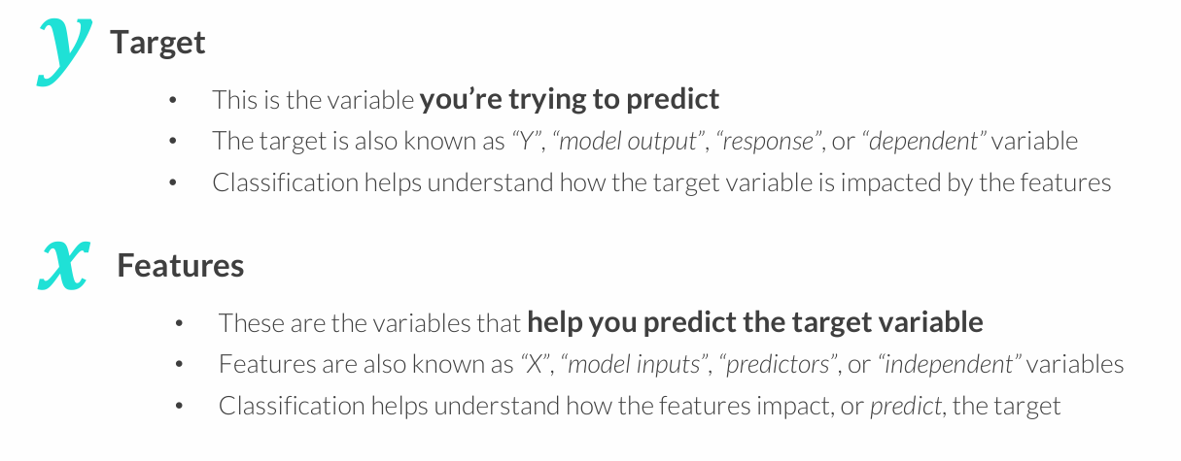
CLASSIFICATION 101
Classification analysis is a supervised learning technique used to predict a categorical variable (target) by modeling its relationship with other variables (features)

Slide 5
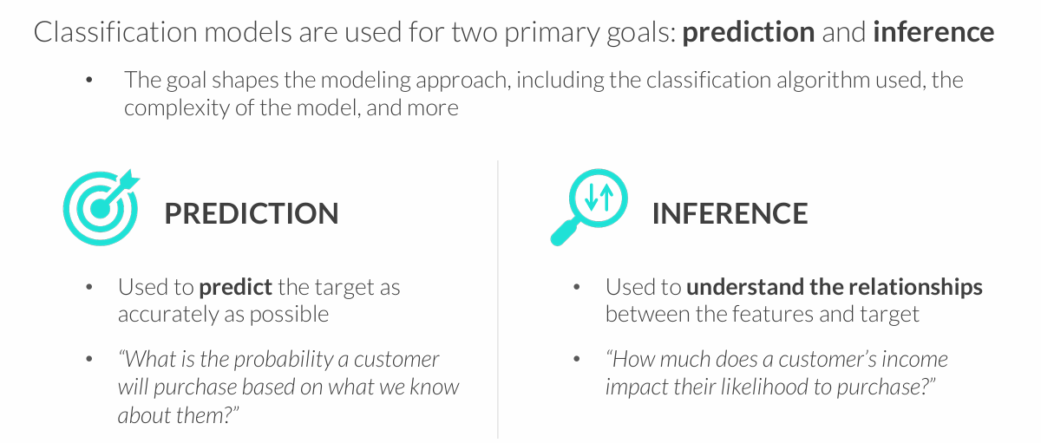
GOALS OF CLASSIFICATION
You often need to strike a balance between these goals – a model that is very inaccurate won’t be too trustworthy for inference, and understanding the impact that variables have on predictions can help make them more accurate

Slide 6
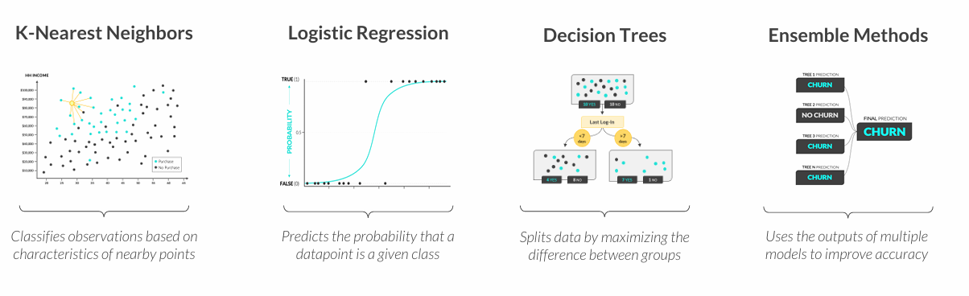
TYPES OF CLASSIFICATION
These are some of the most common types of classification modeling techniques:
All models are wrong, but some are useful
George Box

Slide 7
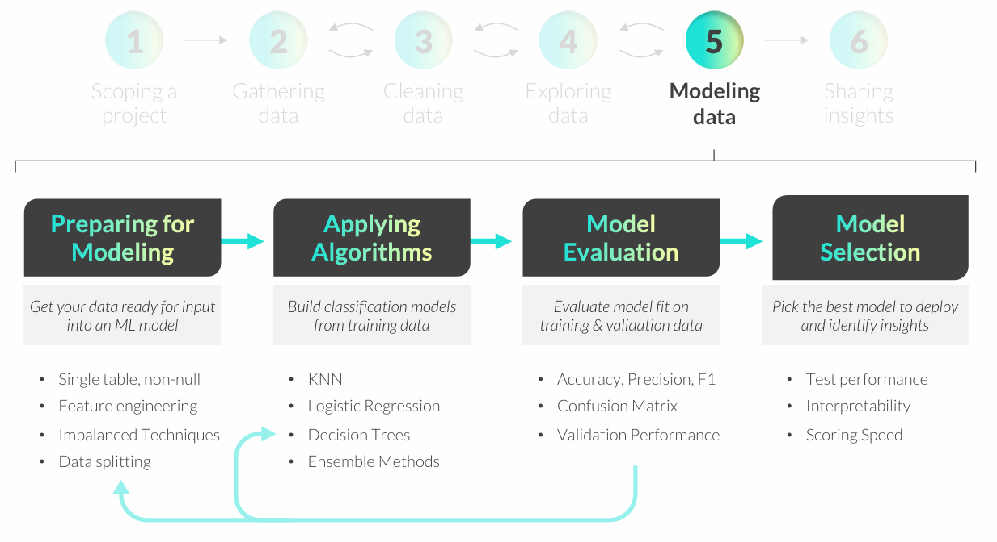
CLASSIFICATION MODELING WORKFLOW

Slide 8
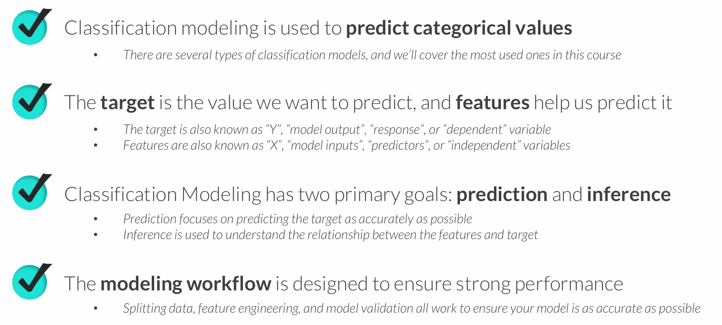
KEY TAKEAWAYS

Slide 9
K-NEAREST NEIGHBORS (KNN)
K-Nearest Neighbors (KNN) is a classification technique designed to predict outcomes based on similar observed values
• In its simplest form, KNN creates a scatter plot with training data, plots a new unobserved value, and assigns a target class based on the classes of nearby points
• K represents the number of nearby points (or “neighbors”) the model will consider when making a prediction
Example use cases:
• Predicting which customers will purchase a product based on demographics
• Classifying customers into pre-existing clusters or segments

Slide 10
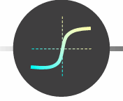
LOGISTIC REGRESSION
Logistic Regression is a classification technique used to predict the probability of a binary (true/false) outcome
• In its simplest form, logistic regression forms an S-shaped (sigmoid) curve between 0 and 1, which represents the probability of a TRUE outcome for any given value of X
• The likelihood function measures how accurately a model predicts outcomes, and is used to optimize the “shape” of the curve
• Although it has the word “regression” in its name, logistic regression is not used for predicting numeric variables
Example use cases:
• Flagging spam emails or fraudulent credit card transactions
• Determining whether to serve a particular ad to a website visitor

Slide 11
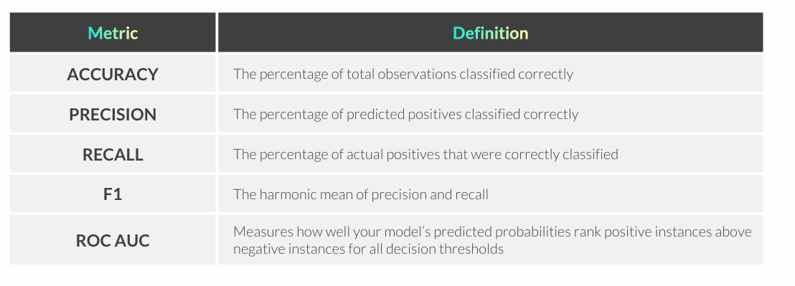
MODEL SELECTION & METRICS
Model selection describes the process of training multiple models, comparing performance on Test data, and choosing the best option
• When comparing performance, it’s important to prioritize the most relevant metrics based on the business context and the problem you are trying to solve

Slide 12

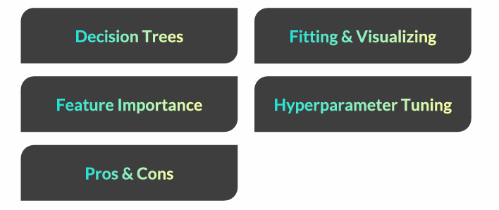
DECISION TREES

Slide 13
DECISION TREES
Decision Trees use a series of binary (true/false) rules to predict multi class or binary outcomes
• For each rule, a decision tree selects a single feature and uses it to split observations into two groups, where each group (ideally) skews towards one class
• The goal is to determine which rules and features do the best job splitting up the classes, which we can measure using a metric known as entropy
• This is NOT a manual process; decision trees test many variables and select rules based on the change in entropy after the split (known as information gain)
Example use cases:
• Predicting if a customer will cancel/churn next month
• Identifying fraudulent bank transactions or insurance claims

Slide 14
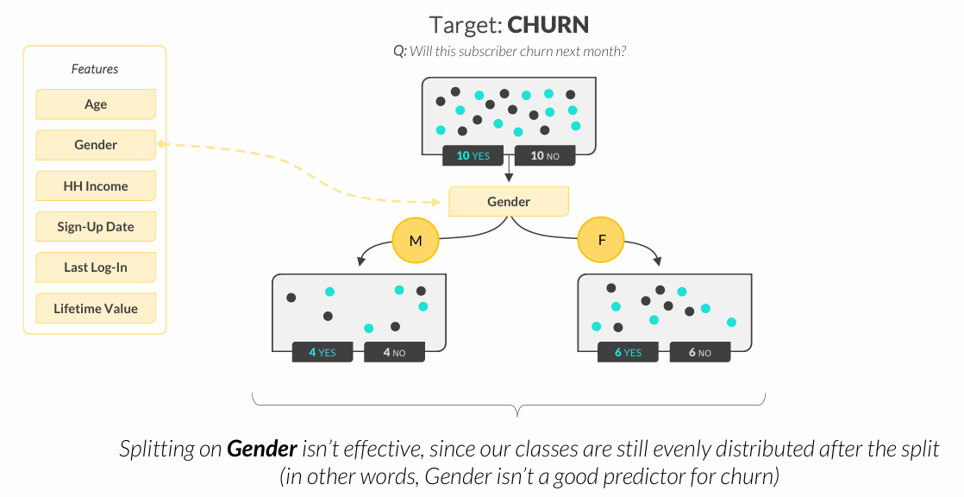
DECISION TREES

Slide 15
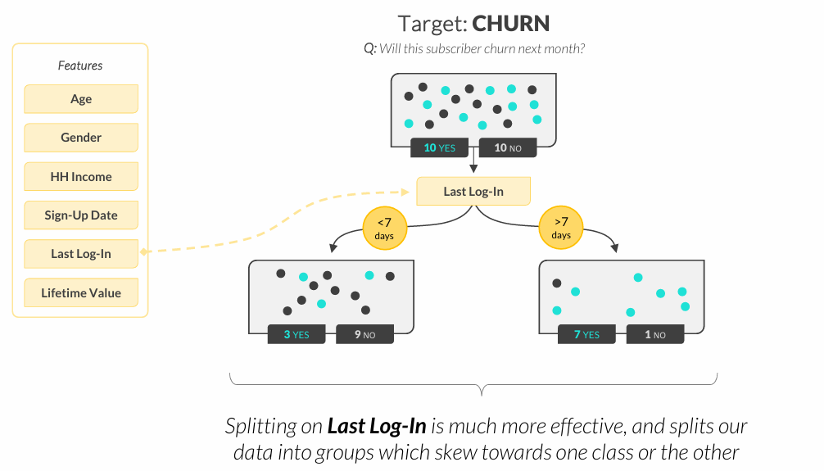
DECISION TREES
How do we know which features to split?
• Entropy measures the “evenness” or “uncertainty” between classes, and can be compared before/after each split to measure information gain
• The model tries all features and multiple splits within each feature to determine which splits reduce entropy the most

Slide 16
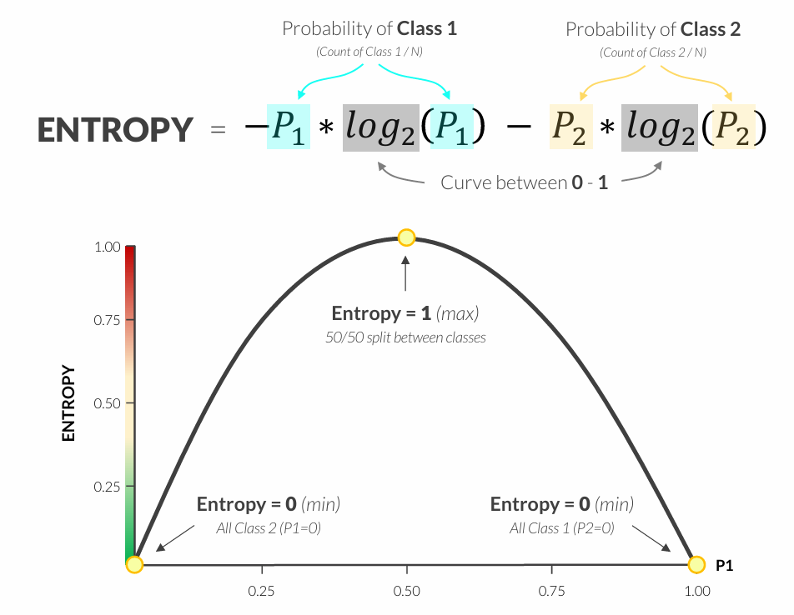
DECISION TREES

Slide 17
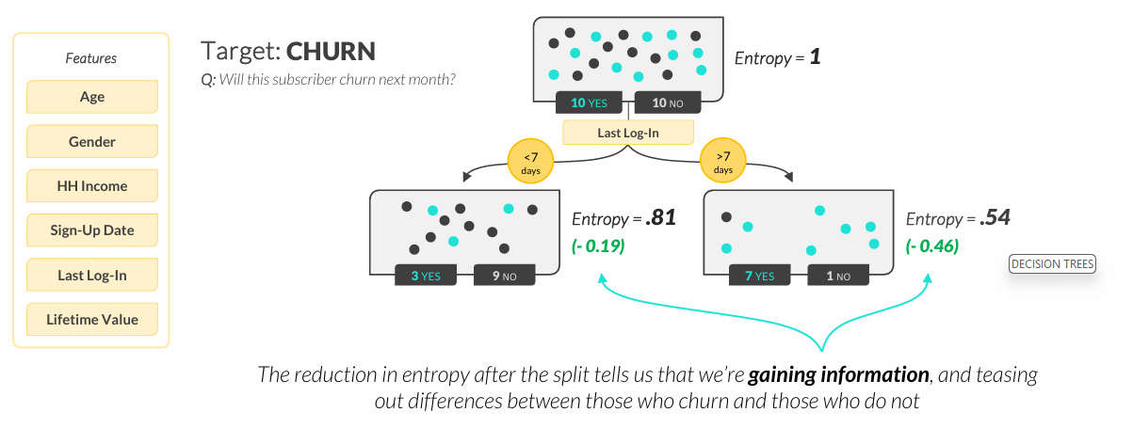
DECISION TREES

Slide 18
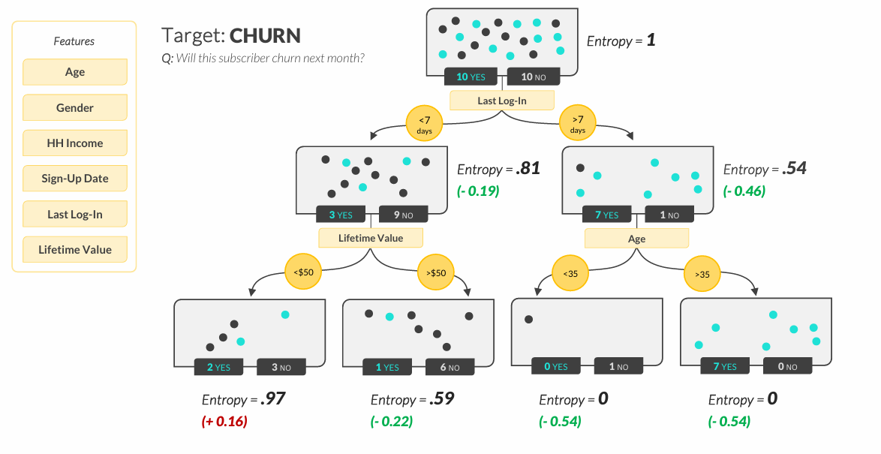
DECISION TREES

Slide 19
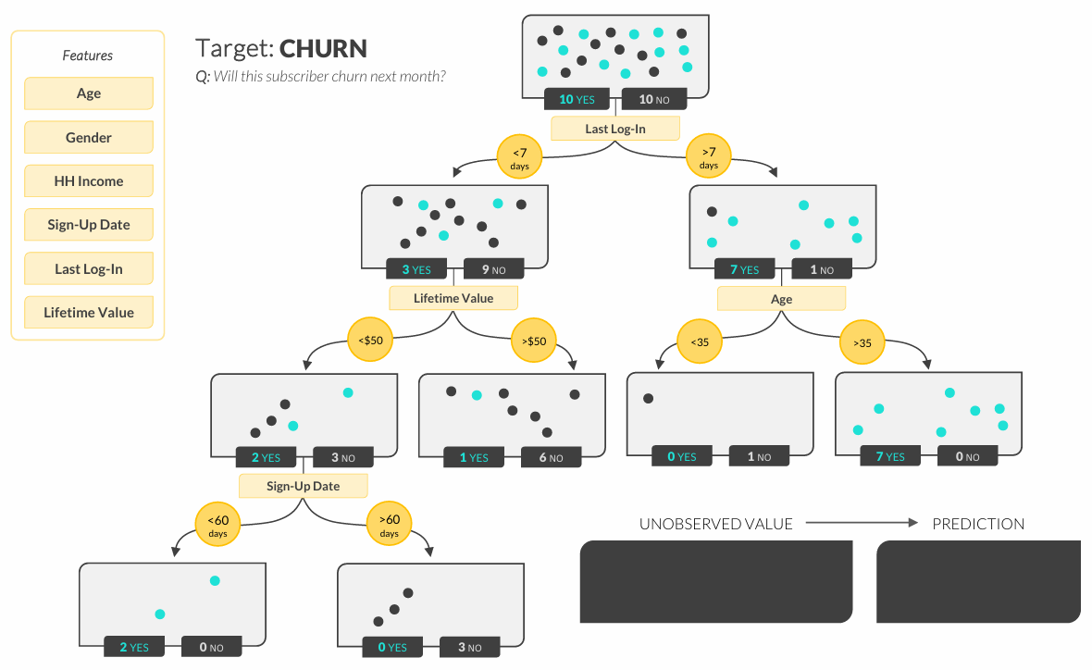
DECISION TREES

Slide 20
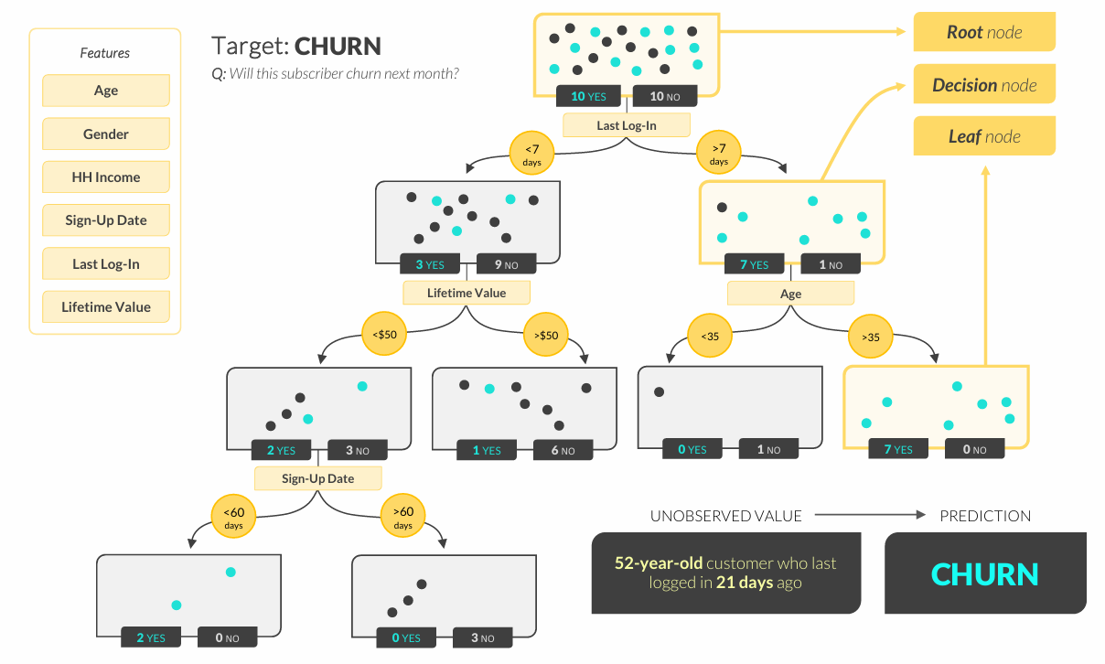
DECISION TREES

Slide 21
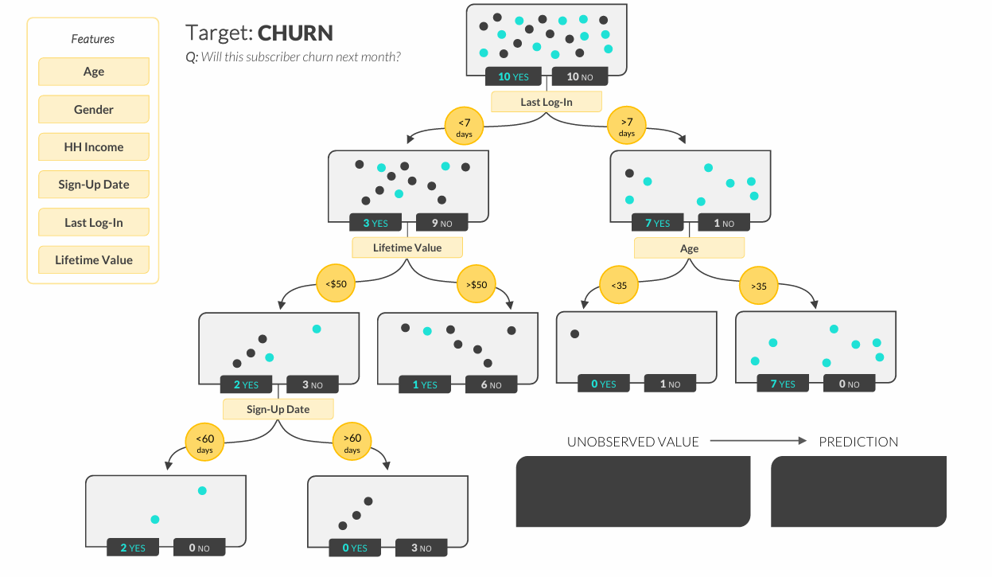
DECISION TREES

Slide 22
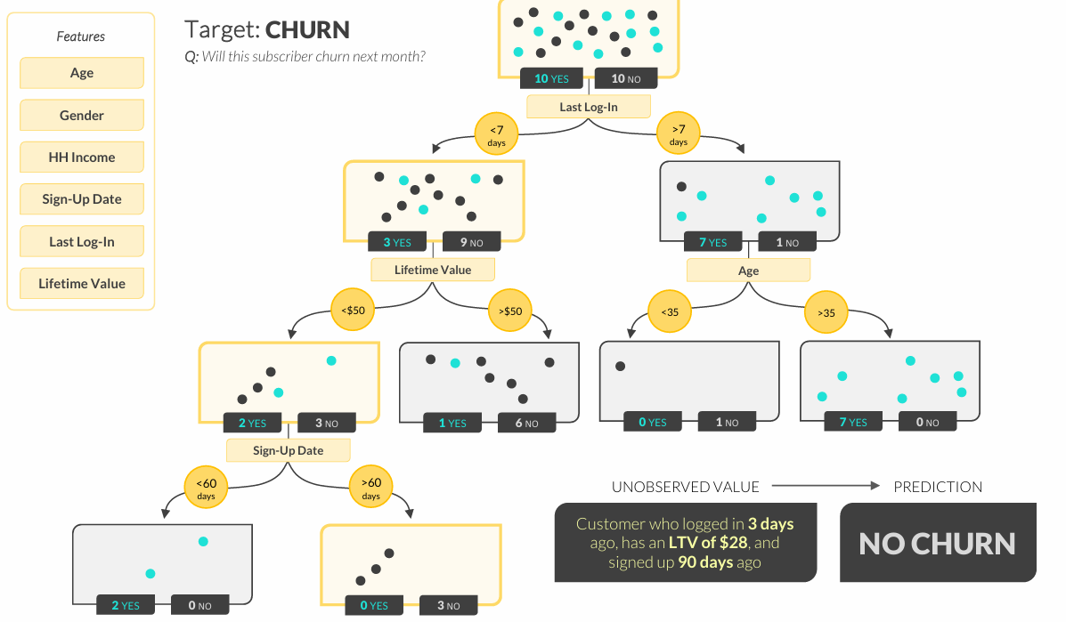
DECISION TREES

Slide 23
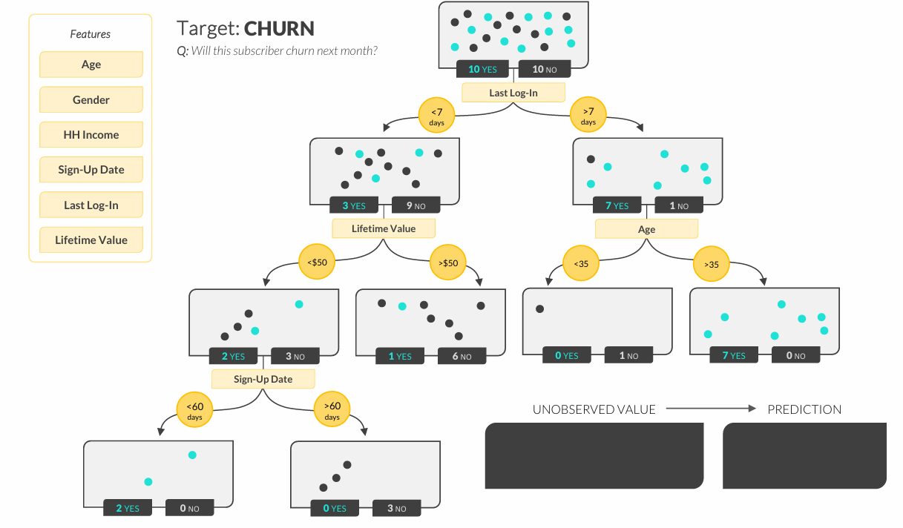
DECISION TREES

Slide 24
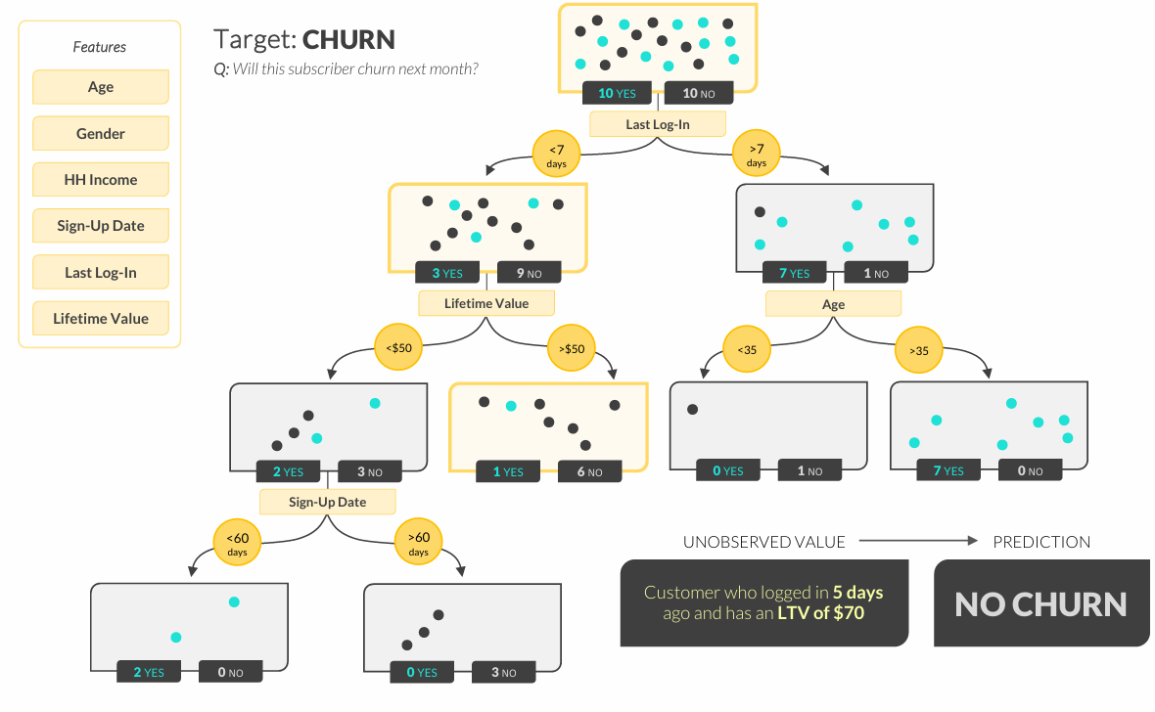
DECISION TREES

Slide 25
DECISION TREES
How do we know when to stop splitting?
• Splitting too much can lead to overfitting, so we need to tune model hyperparameters to limit things like tree depth or leaf size
How do we know where to split numerical features?
• In practice, decision trees will test different numerical splits and optimize based on information gain (just like testing individual features splits)
Does the best first split always lead to the most accurate model?
• Not necessarily! That’s why we often use a collection of multiple decision trees, known as a random forest, to maximize accuracy

Slide 26
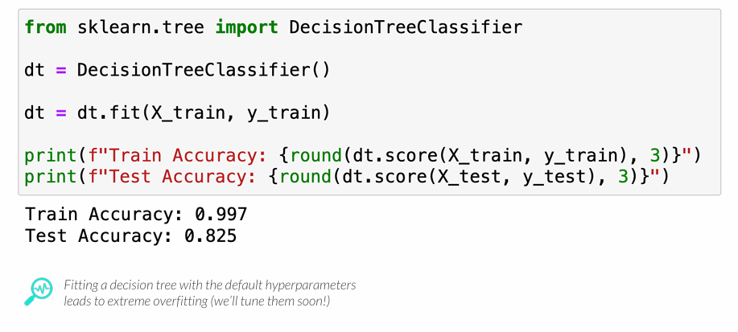
FITTING A DECISION TREE MODEL
In Python, you can fit a decision tree model using the scikit-learn library
• sklearn.tree.DecisionTreeClassifier(max_depth, min_samples_leaf)

Slide 27
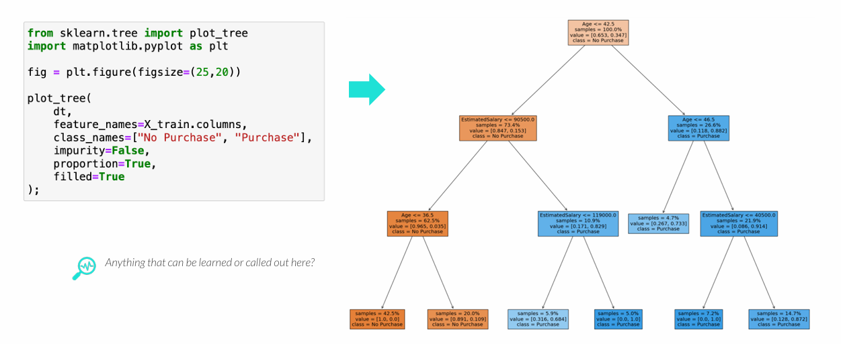
VISUALIZING DECISION TREES
The plot_tree function lets you visualize decision trees
• This helps interpret which splits in the data lead to class predictions
• plot_tree(model, feature_names, class_names, impurity, proportion, filled)

Slide 28
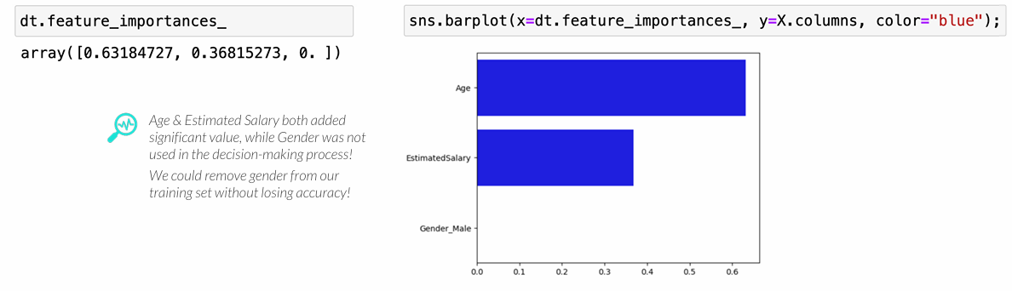
FEATURE IMPORTANCE
Feature importance summarizes how much each feature contributes to the accuracy of a tree-based model
• Feature importance sums to 1 across all features; a score of 1 indicates a feature provides 100% of the decision-making power, while a score of 0 indicates it isn’t used at all
PRO TIP: Feature importance can also be used as an EDA tool by fitting a model with all the features and screening out those with low importance to focus on the useful ones

Slide 29
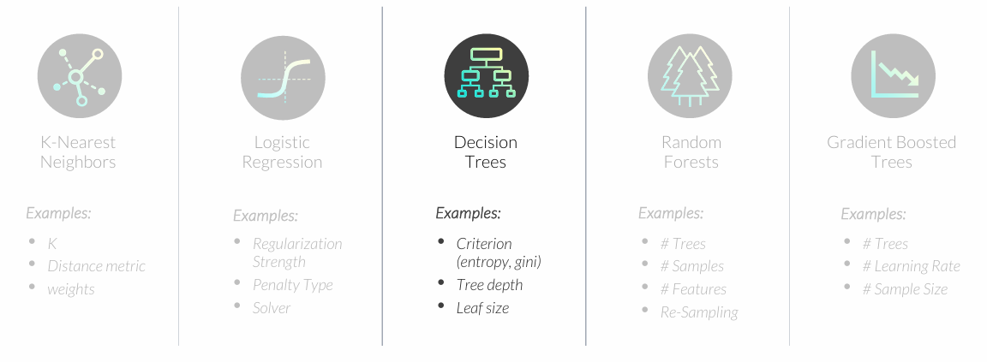
TUNING A DECISION TREE MODEL
Hyperparameters are settings that affect how well a model fits the data
• Unlike model parameters (like regression coefficients) these are not learned from the data
• Parameters are set before the model is fit and optimized based on validation performance

Slide 30
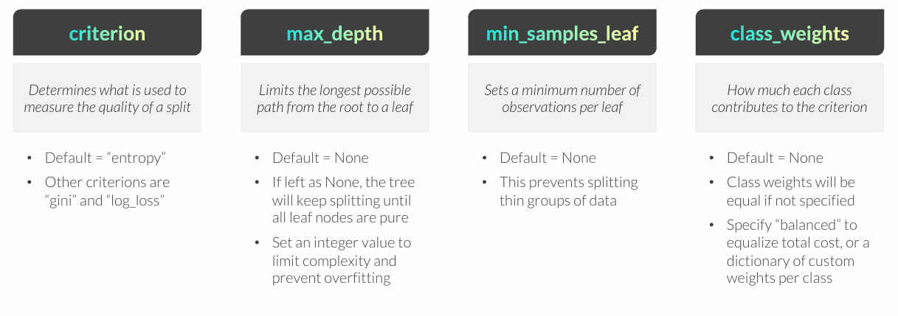
TUNING A DECISION TREE MODEL
The DecisionTreeClassifier function has many hyperparameters that can be tuned
• sklearn.tree.DecisionTreeClassifier(criterion, max_depth, min_samples_leaf, class_weight)
PRO TIP: There are additional hyperparameter options, but in practice you will primarily tune the max_depth and min_samples_leaf hyperparameters

Slide 31
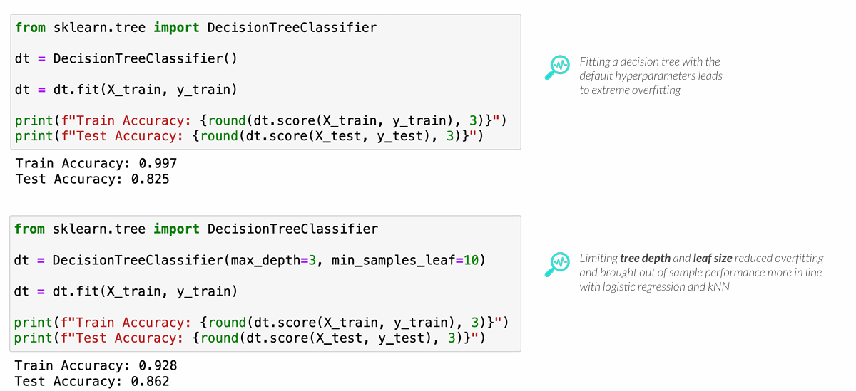
TUNING A DECISION TREE MODEL
The DecisionTreeClassifier function has many hyperparameters that can be tuned
• sklearn.tree.DecisionTreeClassifier(criterion, max_depth, min_samples_leaf, class_weights)

Slide 32
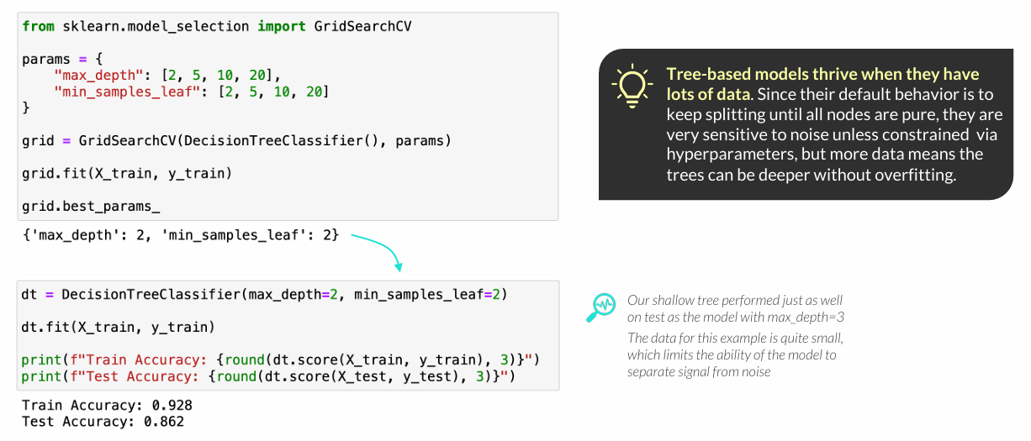
TUNING A DECISION TREE MODEL
You can use GridSearchCV to test various combinations of hyperparameters
• Once you’ve determined the best hyperparameters, fit a final model with them specified

Slide 33
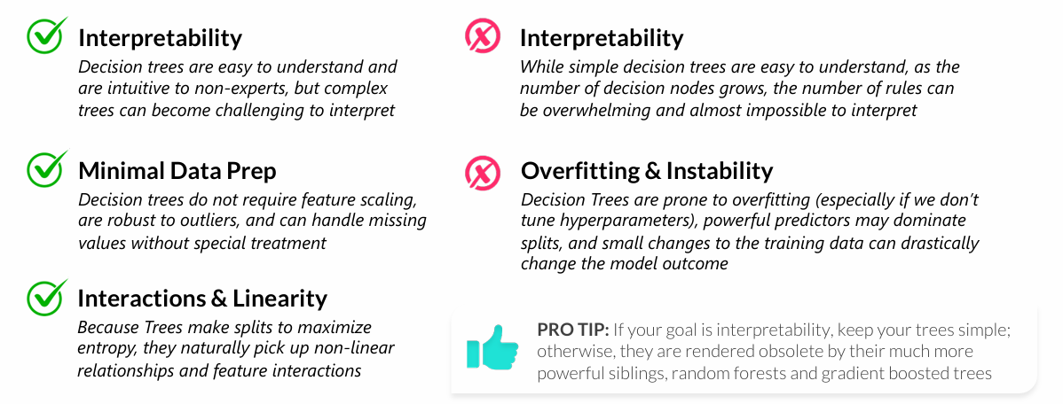
PROS & CONS OF DECISION TREES
Decision Trees have pros and cons that data scientists should be aware of when deciding whether it is the best model for the task at hand
• In general, decision trees are (somewhat) interpretable models that require minimal data preparation, but are very prone to overfitting and can be dominated by strong predictors

Slide 34
KEY TAKEAWAYS
Decision Trees are algorithms that split data to separate classes
• They search for the features and splits within them that yield the “purest” leaves using entropy
Decision Trees can be visualized to help users interpret the model
• Tree diagrams get very complicated as tree depth grows, but even understanding the first few splits can help you understand what is driving the major decisions the model is making
Feature Importance shows which features contribute the most to accuracy
• Consider removing features with a feature importance close to zero, as these may be causing overfitting rather than improving out-of-sample performance
Hyperparameter tuning is critical for preventing overfitting
• By default, trees will keep splitting data until the classes are perfectly separated
• This leads to overfitting unless we constrain the complexity of the tree by setting hyperparameters

